Slide 1

Applications of ICT
Input, Output, and Storage Devices
Week 3 — Lecture 5 & 6
Understanding How Computers Interact with the World

Slide 2

01
Input Devices
Devices that let us send data and instructions into the computer

Slide 3
INPUT DEVICES
Keyboard & Numeric Keypad
A keyboard is the most common input device with letters, numbers, and function keys
It lets you type text, enter commands, and control the computer
A numeric keypad is a small set of number keys, usually on the right side
Keyboards come in wired and wireless types
Special keyboards include ergonomic and foldable designs
Real-World Example
Explanation
A cashier at a supermarket uses a keyboard to enter prices and item codes at the checkout counter.
When you press a key, the keyboard sends a signal to the computer. Each key has a unique code that tells the computer which character to display.
03

Slide 4
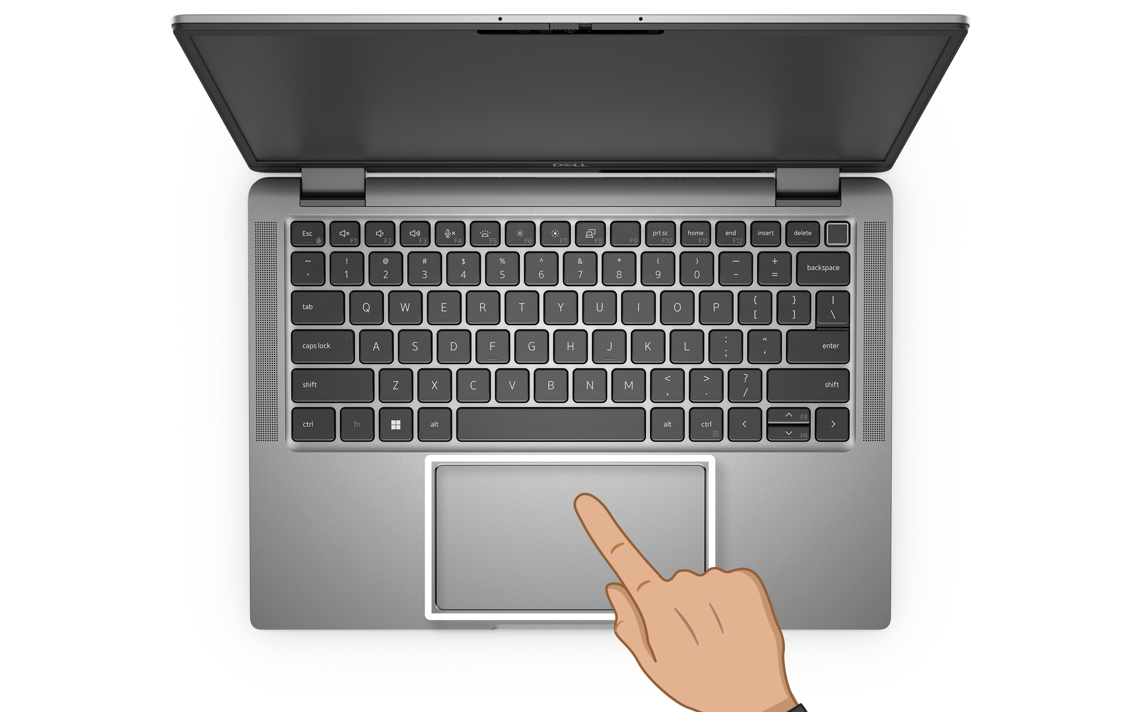
INPUT DEVICES
Pointing Devices — Mouse & Touchpad
A mouse is a handheld device that moves a pointer on the screen
It has buttons to click, select, and open items
A touchpad is a flat surface on laptops that works like a mouse
You slide your finger on the touchpad to move the pointer
Modern mice and touchpads support scrolling and multi-touch gestures
Real-World Example
Explanation
A student uses a mouse to click on icons and open programs on a school computer.
The mouse detects movement and sends it to the computer. The computer then moves the pointer on the screen in the same direction.
04

Slide 5
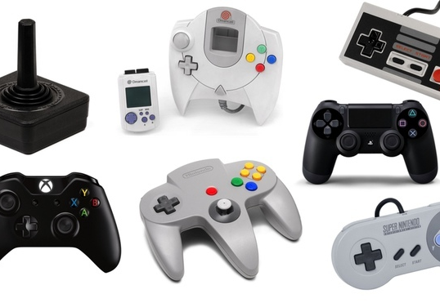
INPUT DEVICES
Remote Control & Joystick
A remote control sends wireless signals to control a device from a distance
It uses infrared (IR) or Bluetooth to communicate
A joystick is a handheld stick used to control games and simulations
A driving wheel is a steering wheel controller for racing games
Both are popular in gaming and entertainment systems
Real-World Example
Explanation
A family uses a TV remote to change channels, and a child uses a joystick to play video games on a console.
Remote controls send signals through the air. Joysticks send movement data to the computer to control what happens in a game.
05

Slide 6

INPUT DEVICES
Touch Screen & Scanners
A touch screen is both an input and output device you touch with your finger
It detects where you touch and sends that location to the computer
A scanner copies physical documents and photos into digital files
Flatbed scanners place items on a glass surface to scan
Sheet-fed scanners pull paper through automatically
Real-World Example
Explanation
A customer uses a touch screen at a fast-food restaurant to place their order, and an office worker scans documents to email them.
Touch screens have a special layer that senses your finger. Scanners use light to read an image and save it as a digital file.
06

Slide 7
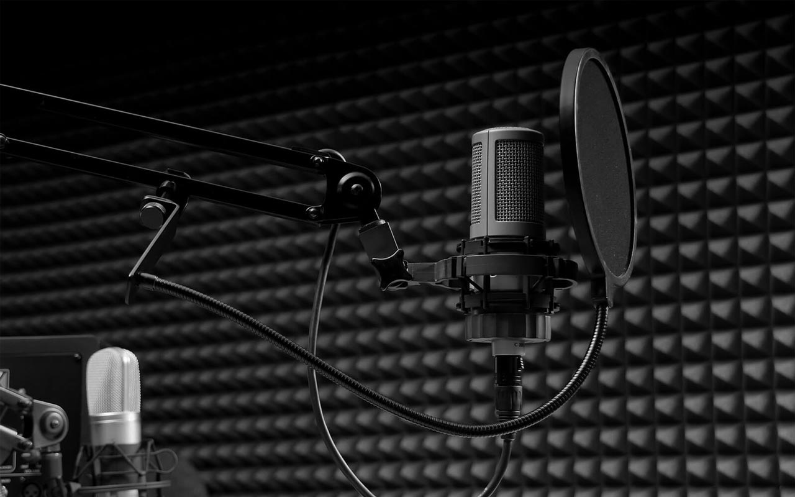
INPUT DEVICES
Camera & Microphone
A camera captures photos and videos as digital input
Webcams are small cameras built into computers for video calls
A microphone records sound and voice as digital input
Headsets combine a microphone with headphones
Both are essential for video meetings and content creation
Real-World Example
Explanation
A teacher uses a webcam and microphone to teach students online through a video call.
Cameras capture light and convert it into digital images. Microphones convert sound waves into electrical signals the computer can understand.
07

Slide 8
INPUT DEVICES
Sensors
Sensors detect changes in the environment and send data to computers
Temperature sensors measure heat and cold
Motion sensors detect movement in a room or area
Light sensors adjust screen brightness based on surrounding light
Proximity sensors detect when something is nearby
Common Sensor Types
Temperature Sensor
Motion Sensor
Light Sensor
Proximity Sensor
Real-World Example
Explanation
A smartphone uses sensors to rotate the screen when you turn the phone, and to count your daily steps.
Sensors are like the computer's senses. They gather information from the real world so the computer can respond automatically.
08

Slide 9
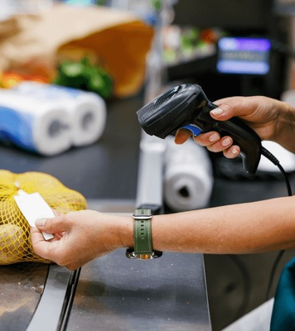
02
Direct Data Entry
Automatic systems that read and input data without typing

Slide 10
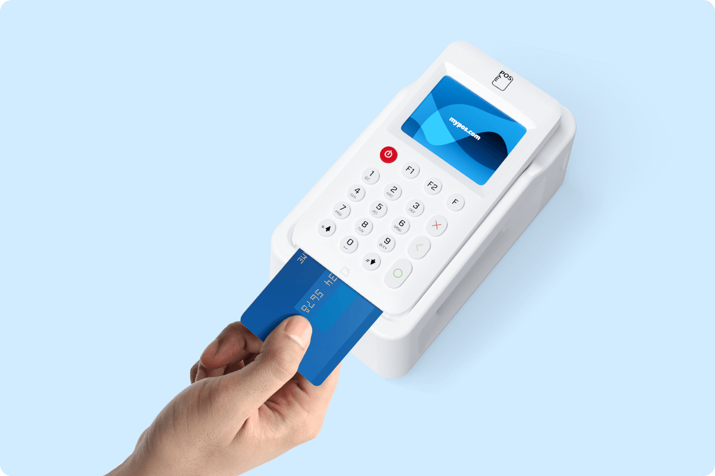
DIRECT DATA ENTRY
Magnetic Stripe Reader & Chip and PIN
A magnetic stripe reader reads the black stripe on the back of cards
It is used on credit cards, debit cards, and ID cards
A chip and PIN reader reads the small chip embedded in modern cards
Chip and PIN is more secure than magnetic stripe
Both are used for payments and identity verification
Real-World Example
Explanation
You swipe your card at an ATM (magnetic stripe) or insert it into a payment terminal (chip and PIN) to withdraw cash.
The stripe stores your account information. The chip creates a unique code for each transaction, making it harder to copy.
10

Slide 11
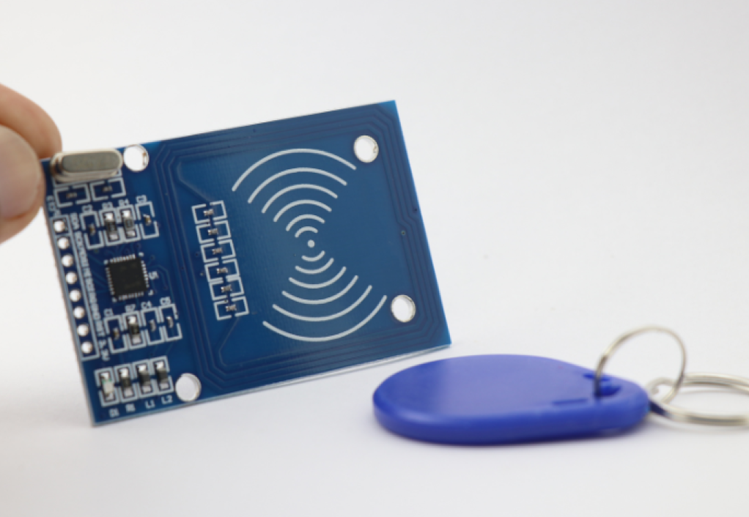
DIRECT DATA ENTRY
RFID Reader
RFID stands for Radio-Frequency Identification
It uses radio waves to read data from a small tag or chip
The tag does not need to touch the reader — it works from a distance
RFID tags are used in passports, pet microchips, and inventory tracking
Active RFID has a battery; passive RFID gets power from the reader
Real-World Example
Explanation
A delivery company puts RFID tags on packages to track them as they move through warehouses.
The RFID reader sends out radio waves. When a tag is nearby, it wakes up and sends back its stored information.
11

Slide 12

DIRECT DATA ENTRY
OMR & OCR
OMR (Optical Mark Recognition) reads marks like ticks or filled circles
It is used for multiple-choice exam answer sheets
OCR (Optical Character Recognition) reads printed and handwritten text
OCR turns scanned documents into editable text files
OMR checks where a mark is; OCR reads what the text says
Real-World Example
Explanation
Schools use OMR to grade exam papers quickly, and OCR is used to convert old printed books into digital e-books.
OMR looks for dark marks in specific places. OCR studies the shapes of letters and converts them into computer text.
12

Slide 13
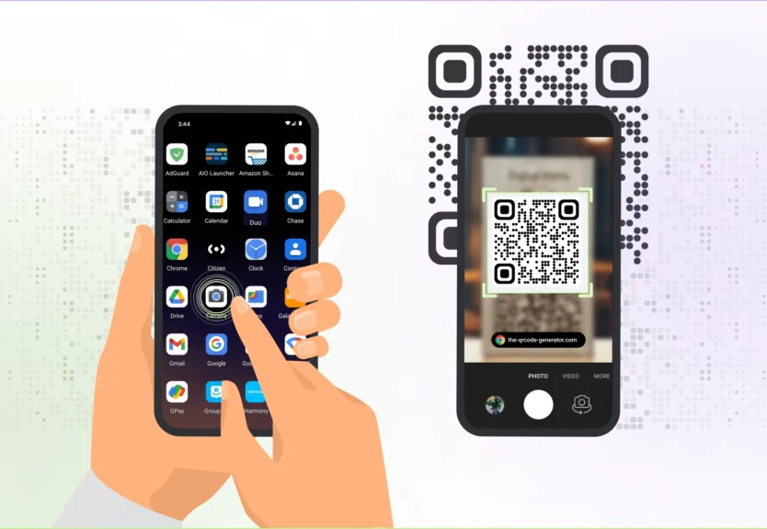
DIRECT DATA ENTRY
Barcode Reader & QR Scanner
A barcode reader scans the black and white lines on products
Each product has a unique barcode with price and item information
A QR scanner reads square-shaped QR codes with a camera
QR codes can store website links, contact info, and payment details
Both make shopping and information sharing faster and easier
Real-World Example
Explanation
A supermarket cashier scans barcodes at checkout, and a person scans a QR code at a restaurant to view the menu.
Barcodes use line patterns to store numbers. QR codes use a grid of dots to store more information, including text and links.
13

Slide 14
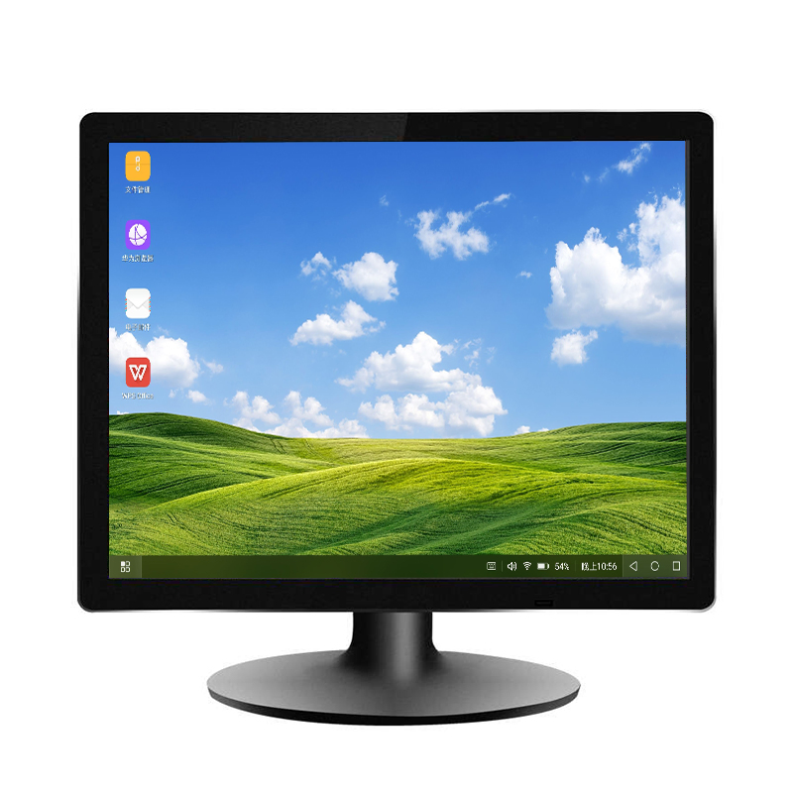
03
Output Devices
Devices that show, play, or print results from the computer

Slide 15
OUTPUT DEVICES
Monitors & Touch Screen as Output
A monitor is the screen that displays text, images, and videos
Common types include LCD, LED, and OLED monitors
Screen size is measured diagonally in inches
Resolution means how many pixels make up the image
A touch screen also works as an output device by displaying results
Real-World Example
Explanation
A graphic designer uses a large high-resolution monitor to edit photos, and a tablet uses a touch screen to both show and control apps.
The computer sends image data to the monitor. The monitor lights up tiny dots (pixels) to create the picture you see.
15

Slide 16
OUTPUT DEVICES
Multimedia Projector
A projector displays the computer screen onto a large wall or screen
It uses light and lenses to make a big image
Projectors are used in classrooms, meeting rooms, and cinemas
They can be connected with HDMI, VGA, or wirelessly
The image size depends on how far the projector is from the wall
How a Projector Works
1
Computer sends image signal
2
Projector receives the signal
3
Light shines through lenses
4
Large image appears on wall
Real-World Example
Explanation
A teacher connects a laptop to a projector to show a lesson on a big screen so all students can see clearly.
The projector takes the image from the computer and shines it through a lens. The lens makes the image large enough for everyone to see.
16

Slide 17
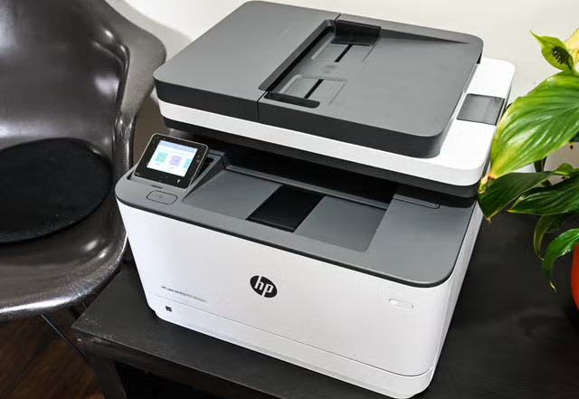
OUTPUT DEVICES
Laser Printer
A laser printer uses a laser beam and toner powder to print
It prints very fast and produces sharp, professional text
Laser printers are best for offices with lots of printing
Toner cartridges last longer than ink cartridges
They work well for documents, reports, and letters
Real-World Example
Explanation
An office worker prints 50 copies of a contract using a laser printer in just a few minutes.
The laser draws the page image on a drum. Toner sticks to the drawn areas, then heat presses the toner onto the paper.
17

Slide 18
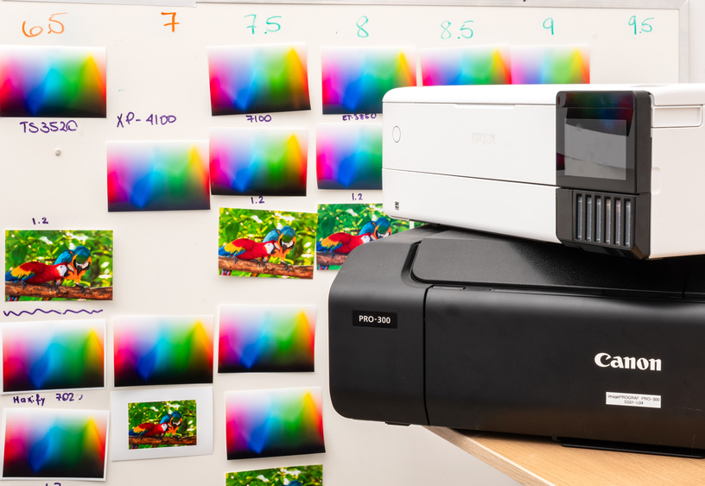
OUTPUT DEVICES
Inkjet Printer
An inkjet printer sprays tiny drops of liquid ink onto paper
It produces high-quality color photos and images
Inkjet printers are affordable and good for home use
They use cyan, magenta, yellow, and black ink cartridges
Photo paper gives the best results for printing pictures
Real-World Example
Explanation
A parent prints colorful family photos at home using an inkjet printer on glossy photo paper.
The print head moves back and forth, spraying thousands of tiny ink dots to build up the image on the paper.
18

Slide 19
OUTPUT DEVICES
Dot Matrix Printer & Plotter
A dot matrix printer uses tiny pins to strike an ink ribbon against paper
It can print on multi-layer forms (carbon copies)
Dot matrix printers are loud but very durable
A plotter uses pens to draw large, detailed designs on paper
Plotters are used for engineering drawings, maps, and banners
Quick Comparison
Dot Matrix
Pins hit ribbon • Carbon copies • Loud • Durable • Low cost
Plotter
Pens draw lines • Large format • Precise • Quiet • Expensive
Real-World Example
Explanation
A warehouse uses a dot matrix printer to print delivery invoices, and an architect uses a plotter to print building blueprints.
Dot matrix printers hit the paper with pins to make dots. Plotters move pens across large paper to create precise lines and drawings.
19

Slide 20
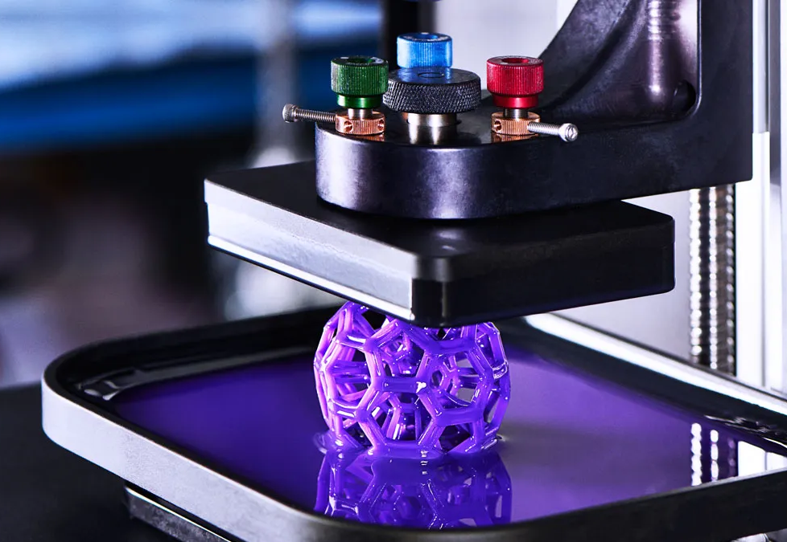
OUTPUT DEVICES
3D Printer, Speaker & Actuator
A 3D printer builds solid objects layer by layer from plastic or resin
It turns digital designs into real physical items
A speaker plays sound and music from the computer
An actuator is a device that moves or controls a physical mechanism
Actuators are used in robots, automatic doors, and factories
Real-World Example
Explanation
A doctor uses a 3D printer to make a model of a patient's bone, and a smart speaker plays music when you ask it to.
3D printers melt material and stack thin layers to build objects. Speakers convert digital sound into vibrations you can hear.
20

Slide 21
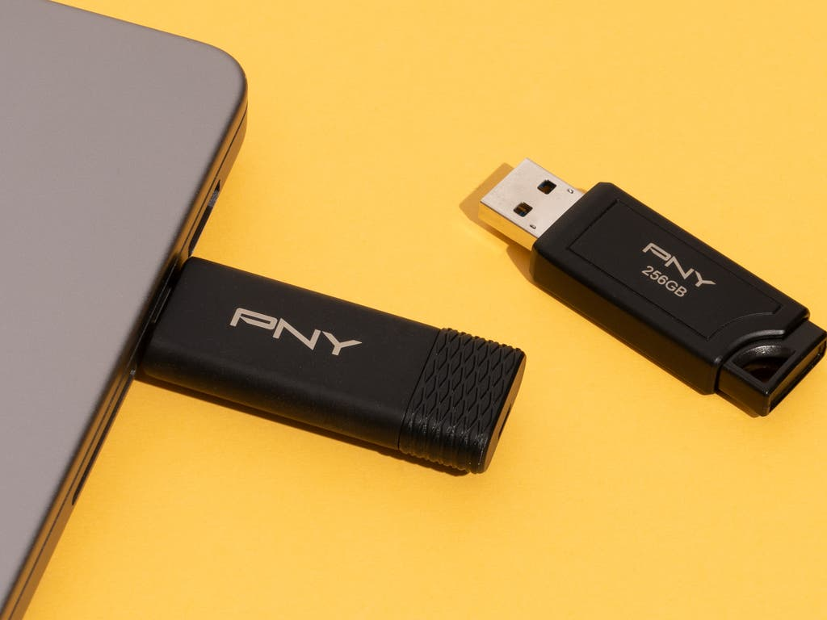
04
Storage Devices
Devices that save data so you can use it again later

Slide 22
STORAGE DEVICES
Introduction to Storage Devices
Storage devices save data permanently so it is not lost when power is turned off
Storage capacity is measured in bytes: KB, MB, GB, and TB
All storage devices have advantages and disadvantages
Speed, capacity, cost, and durability are important factors
There are three main types: Magnetic, Optical, and Solid-State
Three Types of Storage
Magnetic (HDD, Tape)
Optical (CD, DVD, Blu-ray)
Solid-State (SSD, USB)
Each type has different speed, cost, and capacity
Real-World Example
Explanation
You save your school essay on a USB drive so you can open it on a different computer at home.
Think of storage like a filing cabinet. Memory (RAM) is your desk — fast but clears when you leave. Storage is the cabinet — it keeps files safe.
22

Slide 23
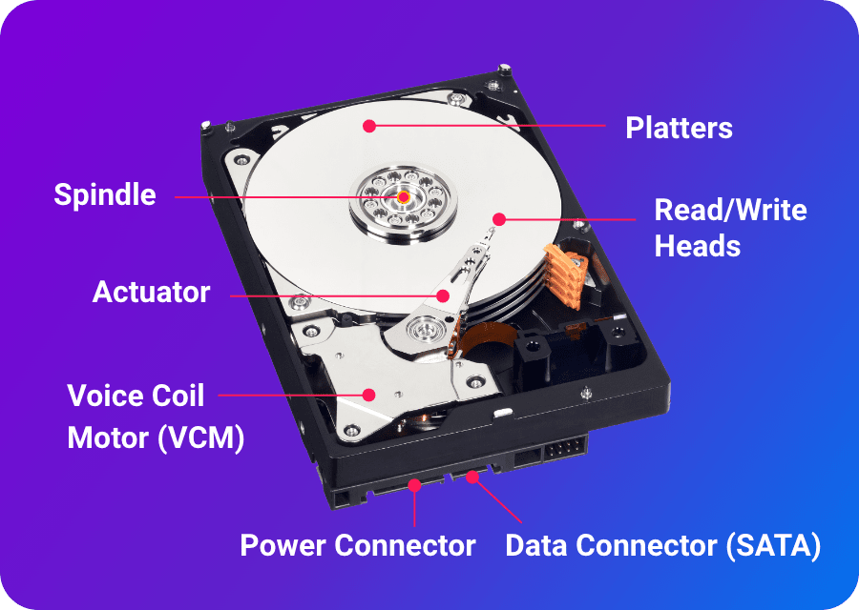
STORAGE DEVICES
Magnetic Storage — Hard Disk Drive (HDD)
A hard disk drive (HDD) uses spinning magnetic disks to store data
It is the most common storage inside desktop and laptop computers
HDDs offer large storage capacity at a low price
They have moving parts, so they can be damaged by drops or shocks
Data is read and written by a magnetic head that floats over the disk
Real-World Example
Explanation
A family computer has a 1TB hard drive that stores thousands of photos, videos, and documents for years.
Imagine a tiny record player inside your computer. The disk spins very fast, and a needle-like head reads and writes data magnetically.
23

Slide 24
STORAGE DEVICES
Magnetic Storage — Tape Drive
A tape drive stores data on a long magnetic tape, like a cassette
Tapes can hold enormous amounts of data very cheaply
Data is stored in a sequence, so finding a file takes longer
Tape drives are mainly used for backup and archiving old data
They are not suitable for everyday file access
HDD vs Tape Drive
Hard Disk Drive
Fast random access • Good for daily use • Moderate cost • Can find files quickly
Tape Drive
Sequential access • Very cheap per GB • Huge capacity • Slow file finding • Backup only
Real-World Example
Explanation
A large hospital backs up all patient records every night onto magnetic tape and stores the tapes in a secure vault.
Tape is like a ribbon with data written along it. To find a file, it winds forward or backward — slow but very cheap for huge data.
24

Slide 25
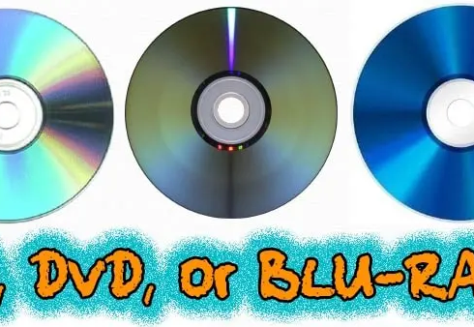
STORAGE DEVICES
Optical Storage — CD & DVD
CDs and DVDs use a laser to read data stored as tiny bumps on a disc
A CD holds about 700 MB of data — enough for 80 minutes of music
A DVD holds 4.7 GB — enough for a full movie
Data is written once on CD-R/DVD-R and cannot be changed
CD-RW and DVD-RW discs can be erased and rewritten
Real-World Example
Explanation
A musician sells their album on CD, and a movie studio releases a film on DVD for home viewing.
A laser beam shines on the spinning disc. The bumps reflect light differently, and the drive reads these reflections as data.
25

Slide 26
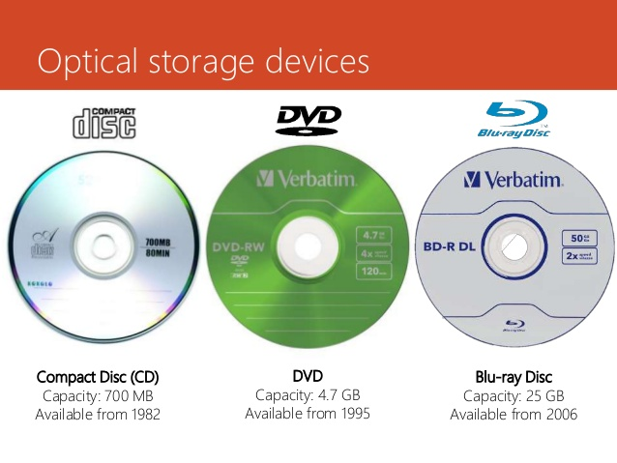
STORAGE DEVICES
Optical Storage — Blu-ray Disc
A Blu-ray disc uses a blue laser to read and write data
It can store 25 GB on a single layer — five times more than a DVD
Dual-layer Blu-ray discs hold up to 50 GB
Blu-ray is used for high-definition movies and large game files
The blue laser has a shorter wavelength, allowing smaller data bumps
Real-World Example
Explanation
A gamer buys a PlayStation game on Blu-ray disc because the game file is too large for a DVD.
The blue laser is more precise than a red laser. This means it can read much smaller bumps, fitting more data on the same-sized disc.
26

Slide 27
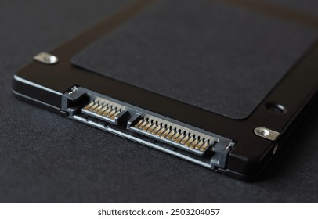
STORAGE DEVICES
Solid-State Storage — SSD
An SSD (Solid-State Drive) stores data on memory chips with no moving parts
It is much faster than a hard disk drive (HDD)
SSDs are lighter, quieter, and more shock-resistant than HDDs
They use less battery power, making them ideal for laptops
SSDs are more expensive per gigabyte than HDDs
Real-World Example
Explanation
A photographer uses an SSD because it opens large photo files in seconds and fits easily in a camera bag.
Unlike HDDs that spin disks, SSDs use electronic chips. This makes them super fast and durable because nothing moves inside.
27

Slide 28
STORAGE DEVICES
Solid-State Storage — Pen Drive & Flash Drive
A pen drive (USB flash drive) is a small, portable solid-state storage device
It plugs into a USB port and works on any computer
Flash drives are lightweight, durable, and easy to carry
They come in sizes from a few GB to over 1 TB
They are perfect for transferring files between computers
Real-World Example
Explanation
A student saves their presentation on a pen drive and plugs it into the classroom computer to give their talk.
A pen drive uses the same chip technology as an SSD but in a tiny, portable case. It needs no power when not plugged in.
28

Slide 29
STORAGE DEVICES
Storage Comparison — HDD vs SSD vs Optical
Feature | HDD | SSD | Optical | USB Flash
Speed | Slow | Very Fast | Slow | Fast
Capacity | Very Large | Large | Small | Medium
Cost | Low | High | Very Low | Medium
Durability | Fragile (moving parts) | Very Durable | Can scratch | Very Durable
Real-World Example
Explanation
A video editor uses an SSD for active projects (speed), an HDD for archived footage (capacity), and Blu-ray for delivering final films.
Each storage type has its own strengths. Choosing the right one depends on whether you need speed, capacity, portability, or low cost.
29

Slide 30
Summary — What You Have Learned
Input Devices
Direct Data Entry
Keyboard, mouse, scanner, camera, microphone, touch screen, sensors, remote, joystick
Barcode, RFID, OMR, OCR, magnetic stripe, chip and PIN, QR scanner
Output Devices
Storage Devices
Monitor, printer (laser, inkjet, dot matrix), speaker, projector, 3D printer, plotter, actuator
HDD, SSD, optical discs (CD, DVD, Blu-ray), USB flash drives, magnetic tape
Each device has advantages and disadvantages —
choose the right tool for the task!
Thank You for Learning!
Week 3 — Lecture 5 & 6 | Applications of ICT

